Slide 1

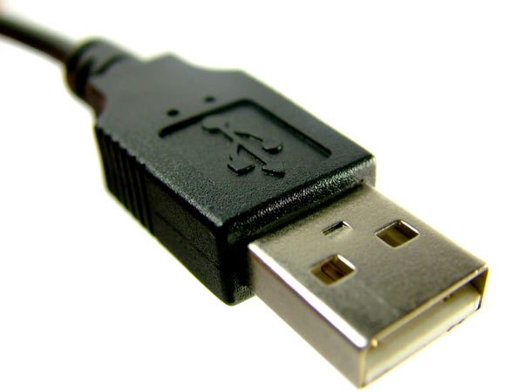
www.studymafia.org
Seminar
On
Universal Serial Bus
Submitted To: Submitted By:
www.studymafia.org www.studymafia.org

Slide 2
Content
History and Evolution
Why We Need USB？
Architectural Overview
USB communication flow
Protocol Layer
Conclusion
References

Slide 3
Key Word
Down：From host to device
Up：From device to host
Example
Down stream：data flow from host to device
Up stream： data flow from device to host

Slide 4
History
USB—Universal Serial Bus
Invented and standardized by a group of computer and peripherals manufactures in 1995
Compete with IEEE1394

Slide 5
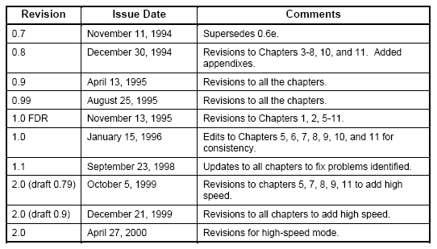
Evolution

Slide 6
Why We Need USB？
Connection of the PC to the telephone：
=>In order to transmit data
Ease-of-use：
=>Saupport plug and play
Port expansion：
=>Up to 127 devices
=>Can add lots of device to a XX

Slide 7
Characteristic (2)
The logical topology of the USB is a star structure
It is similar to computer network
The USB uses a polling protocol
Up to 7 level

Slide 8
USB Can Do
Combines low speed and high speed bus activity , USB enables shared access for both speed
Automatic configuring of devices and a serial bus which is simplified and easy to plug into
Attach / detach easily without restarting system

Slide 9
Architectural Overview
Host：only one
=>The smartest element in the USB system
=>Responsible to the complexity of the
protocol to make devices design simple
and low cost
=>Control the media access（no one can
access the bus unless it get an approval required from the host )

Slide 10
USB System Member (2)
Hub：one or more
=>Like the hubs used for computer network
=>Enables many devices to connect to a single USB port

Slide 11
USB System Member (3)
Device：one or more
=>Everything in the USB system , which is
not a host , is a device ( include hubs)
=>A device may provides one or more USB
functions
=>Has an unique address at the end of the
enumeration process

Slide 12
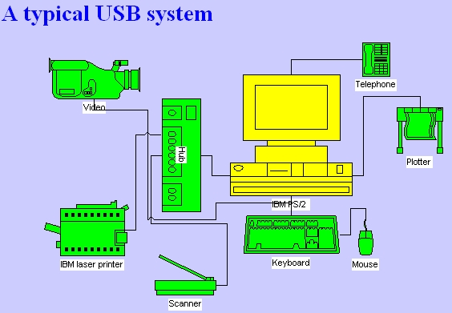
Typical Application

Slide 13
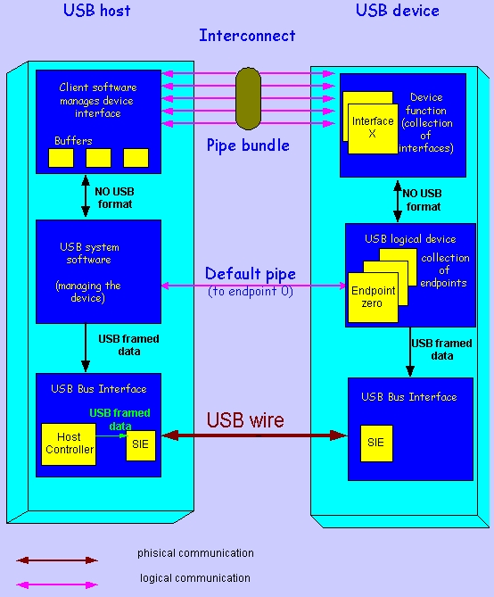
Communication Flow

Slide 14
Pipes (1)
The logic communication between the client
software on the host and the function on the
device is done through pipes
It is a association between a specific
endpoint on the device and the appropriate
software in the host

Slide 15
Pipes (2)
An endpoint is the source or destination of the data that transmitted on the USB cable
Two direction
=>OUT：
data flows from the host to the device
=>IN：
data flows from the device to the host

Slide 16
Signaling On The Bus
The USB cable is 4 wire cable
Signal on the bus is done by signaling over tow wires ( D₊ and D_ )
=>1： D_ low , D₊ high
=>0： D_ high , D₊ low
Data encoding and decoding is done using NRZI ( Non Return to Zero Inverted )

Slide 17
SIE
SIE：Serial Interface Engine
It is part of both the host’s and the device’s physical layer
=>Serialization and Deserialization
=>Encoding and Decoding
=>Generate(for out) and Verify(for in) CRC
=>Detect PID

Slide 18
HC
HC：Host Controller
=>It is an additional hardware to ensure that everything which is transmitted on the bus is correct
=>It serves both the USB and the host and has the same functionality in ever USB system

Slide 19
This Layer Handles
Responsible for the translating the data between the application layer and the USB transactions protocol .
Two Role
=>USB System Software (in the USB host)
=>USB Logical Device (in the USB device)

Slide 20
The USB System SW
Compose of The Host Controller Driver and The USB Driver
Responsible for
=>Bandwidth allocation
=>bus power management
Two of above are in order to enable devices to access the bus

Slide 21
The USB Logical Device
Compose of a collection of independent endpoints
Each endpoint has an unique Endpoint Number and is unidirectional(except endpoint zero and has two type--In/Out)
Default pipe is associated with endpoint zero

Slide 22
The Application Layer
Host end：Client Software
= >Manages the appropriate interface by
transferring data from its buffers to the
endpoint with the appropriate interface
Device end：Function
= >Composed of interfaces and controls the
functionality of the device

Slide 23
Protocol Layer
USB transactions are done through packets include three phases
=>Token phase：host initiates token
indicating the future transfer type
=>Data phase：actual data transmitted
=>Handshake phase：indicate the success or failure of the transaction

Slide 24
Transfer Types (1)
Control Transfer
=>Used to configure a device (enumeration)
=>Compose of three phases (setup,data,status)
Isochronous Transfer
=>Used for multimedia devices
=>It is guarantee the required bandwidth
=>No handshake phase

Slide 25
Transfer Types (2)
Bulk Transfer
=>Used for large burst data
=>Guarantee of delivery , no guarantee of
bandwidth or minimum latency
Interrupt Transfer
=>If there is a pending interrupt , the function
will send details to host after host poll it

Slide 26


Packet (1)
PID：Packet Identifier Field
Address Field
=>So , there are up to 127 devices in USB

Slide 27
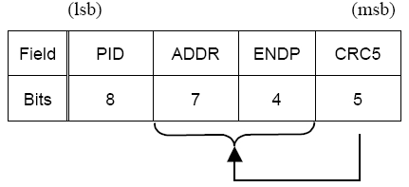
Packet (2)
Token Packet
=>ADDR & ENDP define an unique endpoint

Slide 28
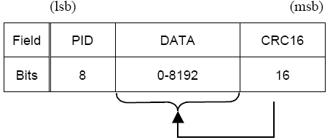
Packet (3)
Data Packet

Slide 29
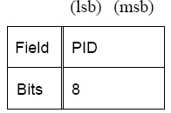
Packet (4)
Handshake Packet
=>Such as ACK 、NAK 、STALL…etc.

Slide 30
Conclusion
USB is powerful and easy to use
The complex host make the device easy to design

Slide 31
Reference
www.google.com
www.wikipedia.com
www.studymafia.org

Slide 32
Thanks

Slide 33
What is USB?
Universal Serial Bus
• A computer peripheral interface
• Ubiquitous across all computer platforms
• Several variations - continues to evolve
• Hot-swapable
• Provides three advantages
– Port expansion
– Performance
– Standard connection method

Slide 34
Four wires (+5V,
Return, data twisted
pair)
• Up to 5 m (16.4 ft)
• Longer connections use
hubs or active
extensions
– Active extension
incorporates a buspowered
hub

